Slide 1
DHCP Configuration
Routing & Switching
Notes:
Cisco Networking Academy program
Routing & Switching
Chapter 10: DHCP

Slide 2
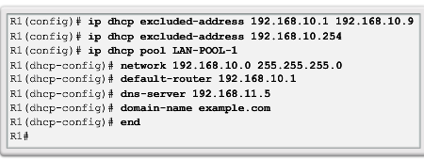
DHCPv4 Operation Configuring a DHCPv4 Server
A Cisco router running the Cisco IOS software can be configured to act as a DHCPv4 server. To set up DHCP:
Exclude addresses from the pool.
Set up the DHCP pool name.
Define the range of addresses and subnet mask. Use the default-router command for the default gateway. Optional parameters that can be included in the pool – dns server, domain-name.
To disable DHCP, use the no service dhcp command.
Notes:
10.1.2.1 Configuring a DHCPv4 Server

Slide 3
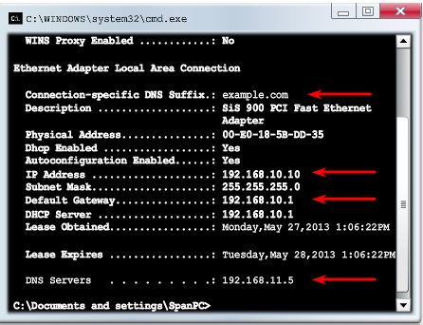
DHCPv4 Operation Verifying a DHCPv4 Server
Commands to verify DHCP:
show running-config | section dhcp
show ip dhcp binding
show ip dhcp server statistics
On the PC, issue the ipconfig /all command.
Notes:
10.1.2.2 Verifying a DHCPv4 Server

Slide 4
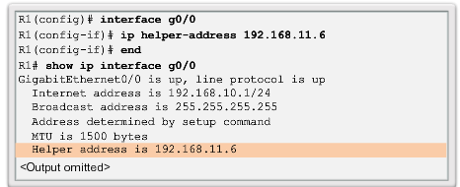
DHCPv4 Operation DHCPv4 Relay
Using an IP helper address enables a router to forward DHCPv4 broadcasts to the DHCPv4 server. Acting as a relay.
Notes:
10.1.2.3 DHCPv4 Relay

Slide 5
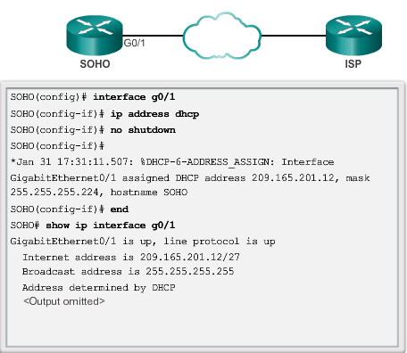
Configuring a DHCPv4 Client Configuring a Router as a DHCPv4 Client
Notes:
10.1.3.1 Configuring a Router as DHCPv4 Client

Slide 6
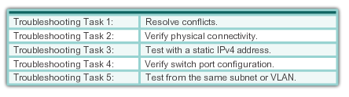
Troubleshoot DHCPv4 Troubleshooting Tasks
Notes:
10.1.4.1 Troubleshooting Tasks

Slide 7
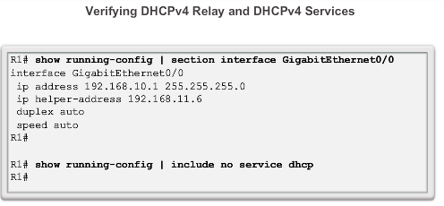
Troubleshoot DHCPv4 Verifying the Router DHCPv4 Configuration
Notes:
10.1.4.2 Verify Router DHCPv4 Configuration

Slide 8
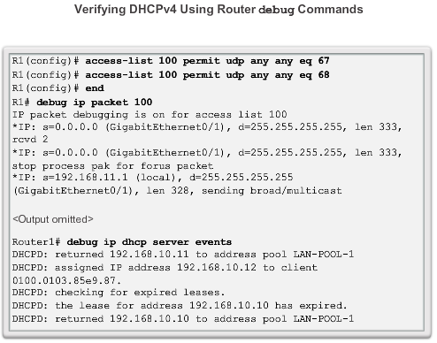
Troubleshoot DHCPv4 Debugging DHCPv4
Notes:
10.1.4.3 Debugging DHCPv4

